Slide 1
Public Key Cryptography
Dr. X
Slides adopted by Prof. William Enck, NCSU

Slide 2
Private-key crypto is like a door lock

Slide 3

Diffie-Hellman key exchange
Notes:
Turing award winners 2015

Slide 4
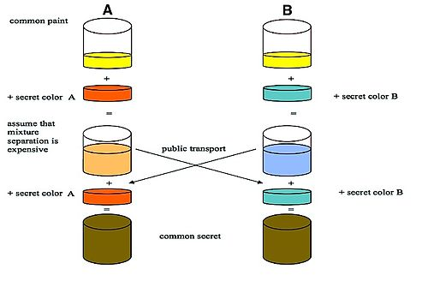
Diffie-Hellman key exchange

Slide 5
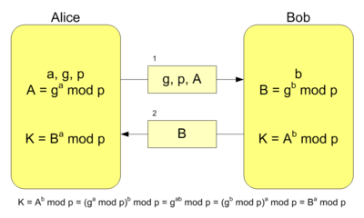
Diffie-Hellman key exchange

Slide 6
Encryption and Message Authenticity

Slide 7
Public Key Crypto (10,000 ft view)
Separate keys for encryption and decryption
Public key: anyone can know this
Private key: kept confidential
Anyone can encrypt a message to you using your public key
The private key (kept confidential) is required to decrypt the communication
Alice and Bob no longer have to have a priori shared a secret key

Slide 8
Public Key Cryptography
Each key pair consists of a public and private component: k+ (public key), k- (private key) D_{k-} (E_{k+} (m)) = m
Public keys are distributed (typically) through public key certificates
Anyone can communicate secretly with you if they have your certificate

Slide 9
Modular Arithmetic
Integers Z_{n} = {0, 1, 2, ..., n-1}
x mod n = remainder of x divided by n
5 mod 13 = 5
13 mod 5 = 3
y is modular inverse of x iff xy mod n = 1
4 is inverse of 3 in Z₁₁
If n is prime, then Z_{n} has modular inverses for all integers except 0

Slide 10
RSA (Rivest, Shamir, Adelman)
The dominant public key algorithm
The algorithm itself is conceptually simple
Why it is secure is very deep (number theory)
Uses properties of exponentiation modulo a product of large primes

Slide 11
Euler’s Totient Function
coprime: having no common positive factors other than 1 (also called relatively prime)
16 and 25 are coprime
6 and 27 are not coprime
Euler’s Totient Function: Φ(n) = number of integers less than or equal to n that are coprime with n where product ranges over distinct primes dividing n
If m and n are coprime, then Φ(mn) = Φ(m)Φ(n)
If m is prime, then Φ(m) = m - 1

Slide 12
Euler’s Totient Function

Slide 13
RSA Key Generation
Choose distinct primes p and q
Compute n = pq
Compute Φ(n) = Φ(pq) = (p-1)(q-1) WHY?
Randomly choose 1<e< Φ(pq) such that e and Φ(pq) are coprime.
e is the public key exponent
Compute de=1 mod(Φ(pq)).
d is the private key exponent
Example: let p=3, q=11, n=33 … find e, d

Slide 14
Public Key Encryption & Decryption
Public key k₊ is {e,n} and private key k₋ is {d,n}
Encryption and Decryption
Ek₊(M) : ciphertext = plaintext^{e} mod n
Dk₋(ciphertext) : plaintext = ciphertext^{d} mod n
Example
Public key (7,33), Private Key (3,33)
M = 4
…

Slide 15
Why does it work?
Difficult to find Φ(n) or d using only e and n.
Finding d is equivalent in difficulty to factoring n as p*q
No efficient integer factorization algorithm is known
Example: Took 18 months to factor a 200 digit number into its 2 prime factors
It is feasible to encrypt and decrypt because:
It is possible to find large primes.
It is possible to find co-primes and their inverses.
Modular exponentiation is feasible.

Slide 16
Is RSA secure?
{e,n} is public information
If you could factor n into p*q, then
could compute φ(n) =(p-1)(q-1)
could compute d = e⁻¹ mod φ(n)
would know the private key <d,n>!
But: factoring large integers is hard!
classical problem worked on for centuries; no known reliable, fast method

Slide 17
RSA Security
At present, key sizes of 1024 bits are considered to be secure, but 2048 bits is better
Tips for making n difficult to factor 1. p and q lengths should be similar (ex.: ~500 bits each if key is 1024 bits) 2. both (p-1) and (q-1) should contain a “large” prime factor 3. gcd(p-1, q-1) should be “small” 4. d should be larger than n^{1/4}

Slide 18
Attacks Against RSA
Brute force: try all possible private keys
can be defeated by using a large enough key space (e.g., 1024 bit keys or larger)
Mathematical attacks 1. factor n (possible for special cases of n) 2. determine d directly from e, without computing φ(n) – at least as difficult as factoring n
http://crypto.stackexchange.com/questions/3043/how-much-computing-resource-is-required-to-brute-force-rsa

Slide 19
Attacks
Probable-message attack (using {e,n})
encrypt all possible plaintext messages with {e, n}
Intercept a message (ciphertext)
try to find a match between the ciphertext and one of the encrypted messages (i.e., collision!)
only works for small plaintext message sizes
This can intercept a secret key that was sent with public key crypto
Solution: pad plaintext message with random text before encryption

Slide 20
Timing Attacks Against RSA
Recovers the private key from the running time of the decryption algorithm
Computing m = c^{d} mod n using repeated squaring algorithm:

Slide 21
Timing Attacks
The attack proceeds bit by bit
Attacker assumed to know c, m • Attacker is able to determine bit i of d because for some c and m, the highlighted step is extremely slow if d_{i} =1
http://www.cs.sjsu.edu/faculty/stamp/students/article.html

Slide 22
Countermeasures to Timing Attacks
1. Delay the result if the computation is too fast
disadvantage: ?
2. Add a random delay
disadvantage?
3. Blinding: multiply the ciphertext by a random number before performing decryption

Slide 23
Digital Signatures
Unforgeable (mandatory)
Authentic (mandatory)
Not alterable (desirable)
Not reusable (desirable)
Notes:
Authenticity and non-repudiation

Slide 24
Digital Signatures
https://dzone.com/articles/what-is-a-digital-signature
Notes:
(1) ensure that the original message was not changed and (2) ensure that message was actually sent by the sender. To accomplish this, we initiate a two-step process, combining our knowledge of cryptographic hashing and public-key encryption. First, we cryptographically hash our message, creating a digest associated with the message. If the message changes, we know that the digest should change.

Slide 25
Digital Signatures
https://dzone.com/articles/what-is-a-digital-signature
Notes:
Compute a digest, D_{S}, for the message using a cryptographic hash.
Encrypt the digest using his or her private key.
Transmit the message, along with the encrypted digest.

Slide 26
Elliptic Curve
https://arstechnica.com/information-technology/2013/10/a-relatively-easy-to-understand-primer-on-elliptic-curve-cryptography/
A private key is a number priv, and a public key is the public point dotted with itself priv times
Computing the private key from the public key: elliptic curve discrete logarithm function -> TRAPDOOR!!

Slide 27
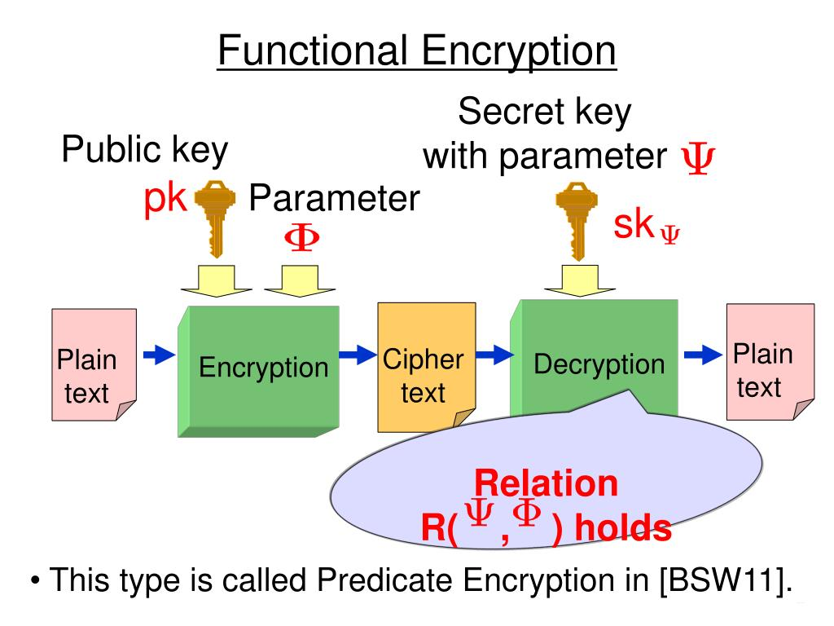
Functional Encryption

